Slide 1



TEAM MEMBER DETAILS
TEAM LEADER NAME: Archi Singhal
BRANCH:Btech STREAM:CSE Year:Ist year
TEAM MEMBER 1 NAME: Jahnavi Pandey
BRANCH:Btech STREAM:CS Year:Ist year
TEAM MEMBER 2 NAME: Ishika Garg
BRANCH:Btech STREAM:CS Year:Ist year

Slide 2
BASIC DETAILS OF TEAM
PROBLEM STATEMENT: People have startup ideas, but don’t know if it’s already done. Can’t measure market need. Have no idea if it’s feasible or valuable.
TEAM NAME: Hacktrix
INSTITUTE NAME: KIET Group Of Institutions, Jaypee Institute of Technology
THEME NAME: Validate Before You Build

Slide 3


Slide 4
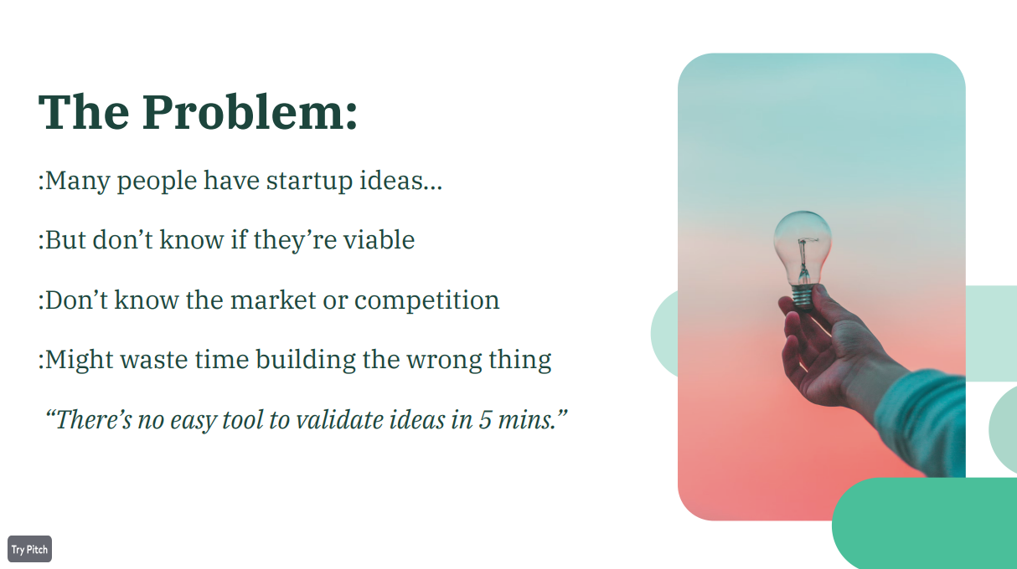

Slide 5


Slide 6
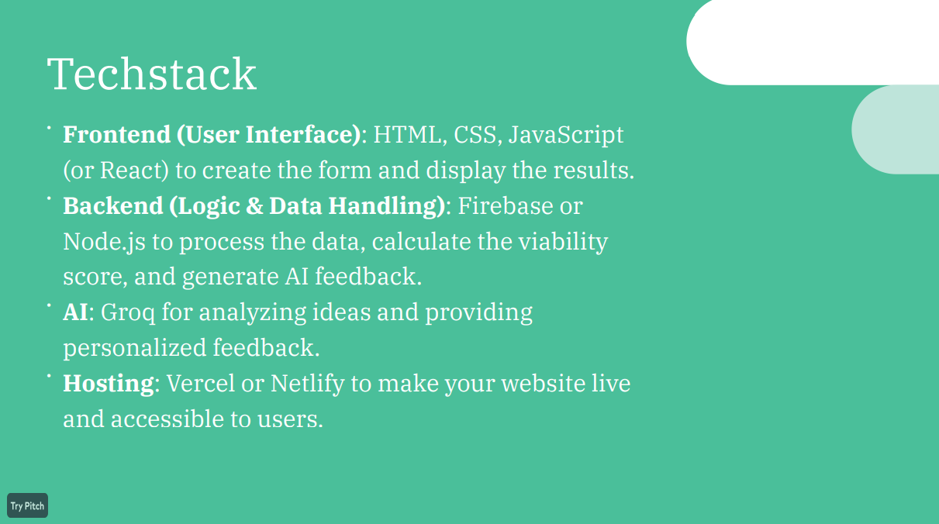

Slide 7


